Slide 1
SQL++ AsterixDB Wrapper Motivation

Slide 2
We motivate the wrapper with an example of a small business review (SBR) website.
Queries are examples of analytics questions an SBR might want an answer for. The SBR has a heterogeneous data set distributed across the following data sources :
a PostgreSQL database
a AsterixDB database
We demonstrate that supporting this dataset with the Forward query processor allows the SBR to answer queries that would otherwise have required extensive application-side programming.

Slide 3
AsterixDB Dataset : The SBR stores their User and Review content in AsterixDB.
drop dataverse RestaurantReviewDemo if exists;
create dataverse RestaurantReviewDemo;
use dataverse RestaurantReviewDemo;
create type UserType as closed {
user_info : {
name : string,
age : int32,
location : string,
interests : {
venue_type : {{ venue : string }},
food_style : {{ category : string }} }
},
user_key : int32
};
create type ReviewType as closed {
user_key : int32,
review_key : int32,
rating : int32,
comments : string,
venue_name : string,
venue_type : string,
food_style : string,
};
create internal dataset Users(UserType) primary key cust_key;
insert into dataset Customers([
{ "user_info" : {
name : "John Smith”,
age : 32,
location : "La Jolla, CA",
interests : {
venue_type : {{"bar", "restaurant"}},
food_style : {{"sushi", "tacos"}}
}
},
"user_key" : 0
},
{ "user_info" : {
name : "Angela Lopez”,
age : 21,
location : "Pacific Beach, CA",
interests : {
venue_type : {{"bar", "nightclub"}}
}
},
"user_key" : 1 }
]);
create internal dataset Reviews (ReviewType) primary key review_key;
insert into dataset Reviews([ {
"user_key" : 0, "review_key" : 0,
"rating" : 2, "comments" : "...",
"venue_name" : "Edo Sushi",
"venu_type" : "restaurant »,
"food_style" : "sushi"},
{"user_key" : 1, "review_key" : 1,
"rating" : 5, "comments" : "...",
"venue_name" : »Edo Sushi",
"venu_type" : "restaurant",
"food_style" : "sushi"},
{"user_key" : 0,"review_key" : 2,
"rating" : 3,"comments" : "...",
"venue_name" : "La rosa de oro",
"venu_type" : "restaurant",
"food_style" : "Tacos"},
{"user_key" : 1,"review_key" : 3,
"rating" : 5, "comments" : "...",
"venue_name" : "Tutti quanti",
"venu_type" : "restaurant",
"food_style" : "italian »}
]);
Complex data type
SQL-style data type

Slide 4
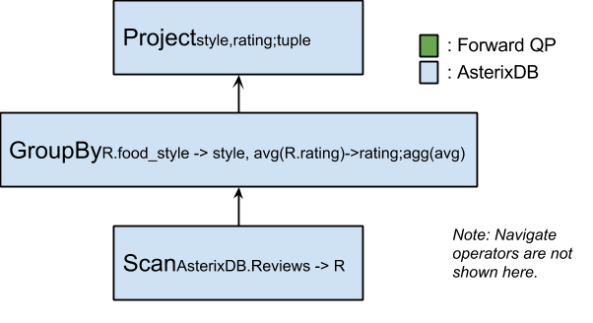
Case 1 : Query can be answered by AsterixDB alone
What is the average rating for reviews for each food style?
SELECT R.food_style as style,
avg(R.rating) AS rating
FROM AsterixDB.Reviews AS R
GROUP BY R.food_style
Query Plan Case 1

Slide 5
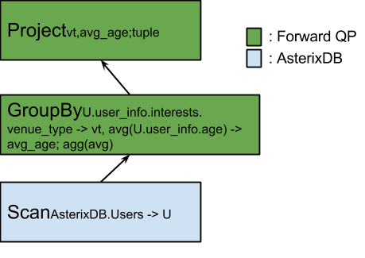
Case 2 : Query cannot be answered by AsterixDB alone
2.a : We want to match users with similar tastes. As a first approach, we want the average age of users that share exactly the same venue type interests :
SELECT U.user_info.interests.venue_type AS vt, avg(U.user_info.age) AS avg_age
FROM
AsterixDB.Users AS U
GROUP BY U.user_info.interests.venue_type
However, AsterixDB does not support complex grouping or complex equality.
Query Plan Case 2.a

Slide 6
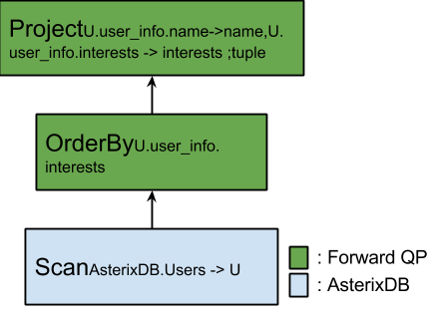
Case 2 : Query cannot be answered by AsterixDB alone
2.b : We want to rank users by how much information they are willing to give us about their interests :
SELECT U.user_info.interests as interests,
U.user_info_name as name
FROM AsterixDB.Users AS U
ORDER BY U.user_info.interests
However, AsterixDB does not support complex ordering or less than comparison.
Query Plan Case 2.b

Slide 7
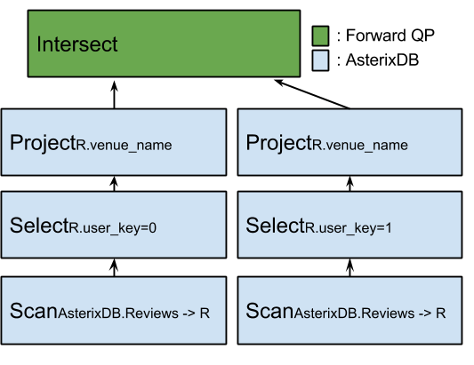
Case 2 : Query cannot be answered by AsterixDB alone
2.c : We want to know which restaurants have been reviewed by John and Angela (user keys 0 and 1).
SELECT R.venue_name
FROM AsterixDB.Reviews AS R
WHERE R.user_key = 0
INTERSECT
SELECT R.venue_name
FROM AsterixDB.Reviews AS R
WHERE R.user_key = 1
AsterixDB does not support bag operators.
Query Plan Case 2.c

Slide 8
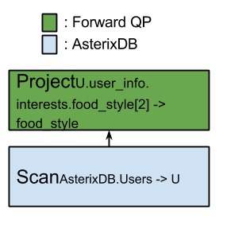
Case 2 : Query cannot be answered by AsterixDB alone
2.d : We want the second listed food style interest of each user.
SELECT U.user_info.interests.food_style[2] AS food_style
FROM AsterixDB.Users AS U
This query would result in an error in AQL (type mismatch). What should Forward do about it?
Suggestion : let Forward handle navigation with its own navigation semantics.
Alternative : return output from Asterix.
Query Plan Case 2.d

Slide 9
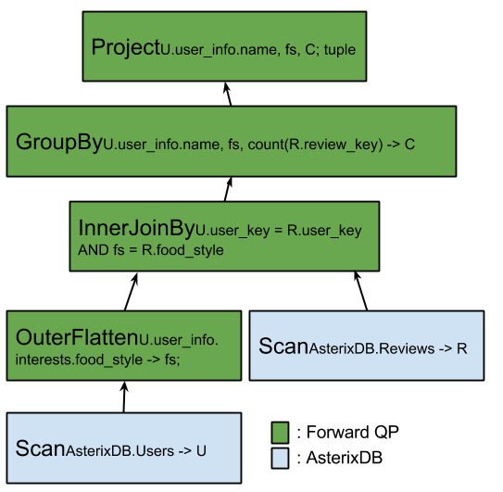
Case 2 : Query cannot be answered by AsterixDB alone
2.e : We want to know how well users indicate their interests. In particular, we want to know how many of the reviews they write correspond to their declared food interests. For each user's food interest, we count how many reviews that user wrote which matched that user’s interest :
SELECT U.user_info.name,fs,COUNT(R.review_key) AS C
FROM AsterixDB.Reviews AS R
JOIN OUTER FLATTEN (
AsterixDB.Users AS U,
U.user_info.interests.food_style AS fs
)
ON U.user_key = R.user_key AND fs = R.food_style
GROUP BY U.user_info.name, fs
Notice that if we used INNER FLATTEN, Angela would not show up in the records (she did not declare any food style interest). OUTER FLATTEN, on the other hand, is not supported by AsterixDB.
Query Plan Case 2.e
OuterFlatten is not an operator yet in the specification

Slide 10
PostrgeSQL Dataset : The company has decide to compensate reviewers who write good quality reviews. All reviews are given price tags. Reviewers get compensated the sum of their price tags by the end of the month. Reviews that haven't been analyzed or not been considered good enough are given a price tag of 0.
CREATE TABLE PriceTag (
pt_key int primary key not null,
user_key int not null,
review_key int not null,
amount double not null,
timestamp timestamp default current_timestamp
)
INSERT INTO PriceTags(
pt_key,
user_key,
review_key,
amount
) VALUES
(0,0,0,1.23),
(1,0,1,1.55),
(2,0,2,3.53),
(3,1,3,0.0)
);

Slide 11
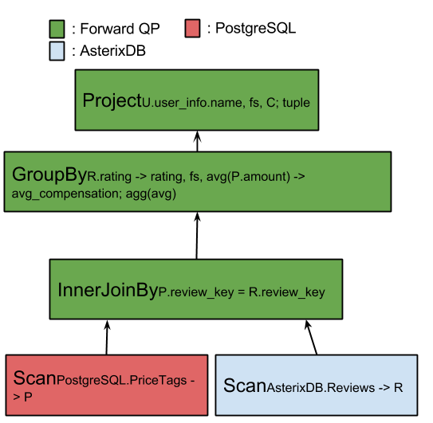
Case 3 : Query uses data from AsterixDB and PostgreSQL
3.a : What is the average compensation for each rating grade (rating grades are integers from 1 to 5)?
SELECT R.rating AS rating, AVG(P.amount) AS avg_compensation
FROM AsterixDB.Reviews AS R
JOIN PostgreSQL.PriceTags AS P
ON P.review_key = R.review_key
GROUP BY R.rating
In this case, the inner join can be done on the mediator.
Query Plan 3.a

Slide 12
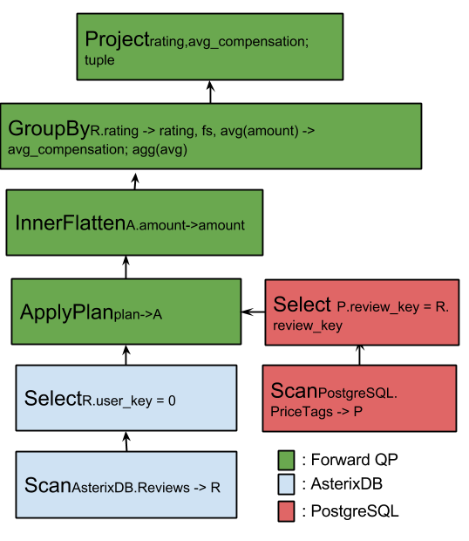
Case 3 : Query uses data from AsterixDB and PostgreSQL
3.b : What is the average compensation for each rating grade of John Smith (user_key=0) ?
SELECT R.rating, AVG(P.amount)
FROM AsterixDB.Reviews AS R
JOIN PostgreSQL.PriceTags AS P
ON P.review_key = R.review_key
WHERE R.user_key = 0
GROUP BY R.rating
In this case, there is a great incentive to have the inner join done in PostgreSQL. We can do this by doing an apply plan rewriting (inner flatten necessary if more than one price tag per review).
Query Plan 3.b

